Slide 1






SMALL BUSINESS ANALYSIS

Slide 2



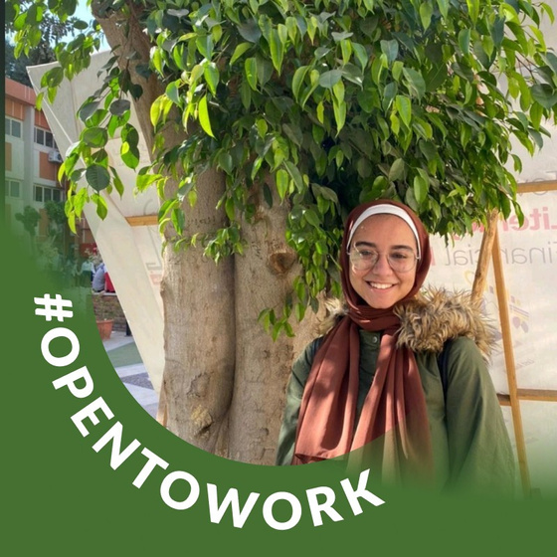
TEAM
Hager Lialy
Sandy Nazeh
Dina Mohamed
Omnya Talaat
Under the Supervision of: Dr.Amal Mahmoud

Slide 3
INTRODUCTION
Why did we choose this project?
As we can see, this initiative aims to empower young people and enable them to generate income through freelancing. We found that this project aligns with what the initiative seeks to achieve, as starting a small business does not require completing education, and you can use social media platforms to reach this goal by selling your products online.

Slide 4
OBJECTIVES

Slide 5
InsideOut wanted to better understand its customers and optimize marketing efforts to increase sales and customer satisfaction.

Slide 6
1 - ANALYZE CUSTOMER BEHAVIOR & SATISFACTION
Understand the demographics, brand perception, and satisfaction of customers.
2 - SALES PERFORMANCE ANALYSIS
Explore product preferences, sales trends, and the impact of currency fluctuations on sales
3 - SOCIAL MEDIA CAMPAIGN EVALUATION
Assess the effectiveness of marketing across different platforms by analyzing engagement metrics (likes, shares, views).
4 - DATA-DRIVEN RECOMMENDATIONS
Provide actionable strategies to improve customer engagement, optimize marketing, and drive sales growth.

Slide 7
CHALLENGES
Data Integration: Combining sales data, marketing insights, and customer surveys from different sources was challenging.
Social Media Data Collection: Manual collection of marketing metrics from each platform (Facebook, Instagram, TikTok) required effort and accuracy.

Slide 8
MOTIVIATION
Improving Brand Positioning: Understanding why customers choose InsideOut over competitors.
Boosting Sales: Identifying effective marketing strategies and understanding product demand.
Customer Engagement: Addressing customer needs to increase loyalty and repeat purchases.

Slide 9
METHODOLOGY

Slide 10
1- DATA COLLECTION
Sales data was collected and structured into CSV files and an SQLite database.
Social Media data from Facebook, Instagram, and TikTok was manually collected and analyzed.
Customer surveys were conducted to gather feedback on satisfaction, purchasing behavior, and preferences.

Slide 11
2- DATA ANALYSIS TOOLS
SQL & SQLite for database management and querying.
Python (Pandas, Matplotlib, NumPy, Seaborn) for data cleaning, analysis, and visualizations.
R (dplyr, ggplot2, DBI) for data cleaning, analysis, and visualizations.
Excel for data management, summary statistics, and additional data visualizations.
Tableau for creating interactive dashboards and visual insights.

Slide 12
3- KEY ANALYSIS
Social Media Analysis: Evaluating engagement across different content types and platforms.
Sales Analysis: Exploring sales trends based on demographics, product types, and external factors (e.g., dollar exchange rate).
Survey Data Analysis: Understanding customer preferences and satisfaction through feedback.

Slide 13
CONTRIBUTION

Slide 14
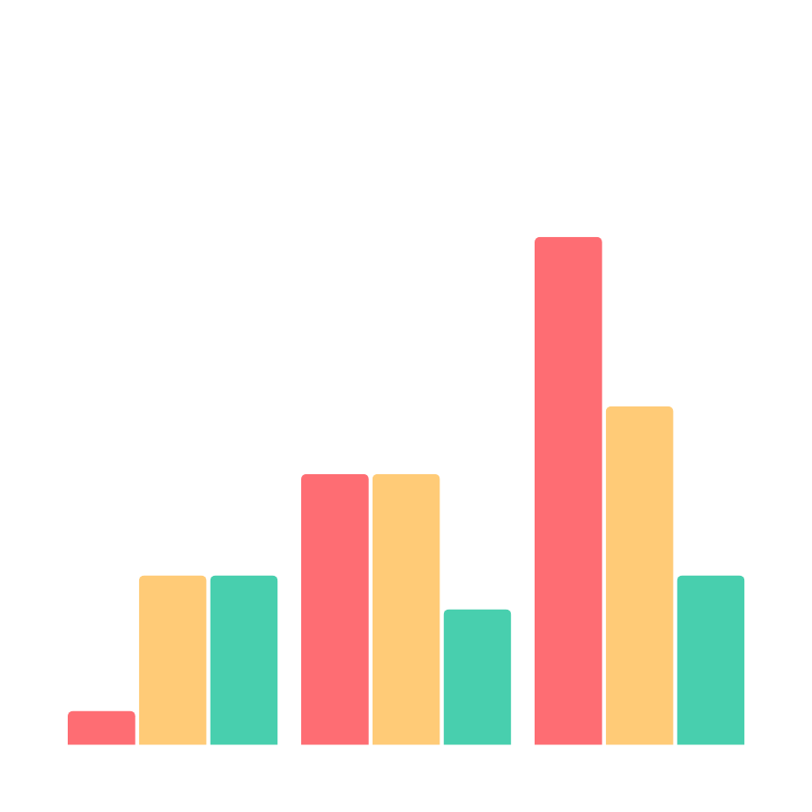
SALES INSIGHTS
Female customers account for the overwhelming majority of sales, while male engagement is very low.
The 1-Year Planner vastly outperforms the 6-Month Planner in terms of sales.
There were significant cancellations in December 2023.
Cairo and Giza dominate sales, indicating strong market penetration. Alexandria is also performing reasonably well.
December consistently sees the highest order volume, especially during the holiday season.

Slide 15
SOCIAL MEDIA INSIGHTS
Engagement varies by content type, with storytelling and selling content generating the most interaction.
Reels outperform other formats in engagement.
Higher view counts generally lead to more orders, but some months have high views without corresponding sales.
There is a direct realtionship between the number of selling content posts and orders.

Slide 16
FIND MORE INSIGHTS AND RECOMMINDATION AT OUR DOCUMENTATION FILE !

Slide 17
QUESTIONS?

Slide 18
THANK YOU

